Slide 1

Chapter 1 Introduction to Computers, Programs, and Java

Slide 2
Chapter 14 Abstract Classes and Interfaces

Slide 3
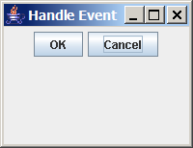
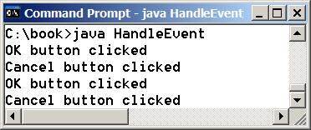
Motivations
You learned how to write simple programs to display GUI components. Can you write the code to respond to user actions such as clicking a button?
HandleEvent
Run

Slide 4
Objectives
    To design and use abstract classes (§14.2).
    To process a calendar using the Calendar and GregorianCalendar classes (§14.3).
    To specify common behavior for objects using interfaces (§14.4).
    To define interfaces and define classes that implement interfaces (§14.4).
    To define a natural order using the Comparable interface (§14.5).
    To enable objects to listen for action events using the ActionListener interface (§14.6).
    To make objects cloneable using the Cloneable interface (§14.7).
    To explore the similarities and differences between an abstract class and an interface (§14.8).
    To create objects for primitive values using the wrapper classes (Byte, Short, Integer, Long, Float, Double, Character, and Boolean) (§14.9).
    To create a generic sort method (§14.10).
    To simplify programming using automatic conversion between primitive types and wrapper class types (§14.11).
    To use the BigInteger and BigDecimal classes for computing very large numbers with arbitrary precisions (§14.12).
    To design the Rational class for defining the Rational type (§14.13).

Slide 5
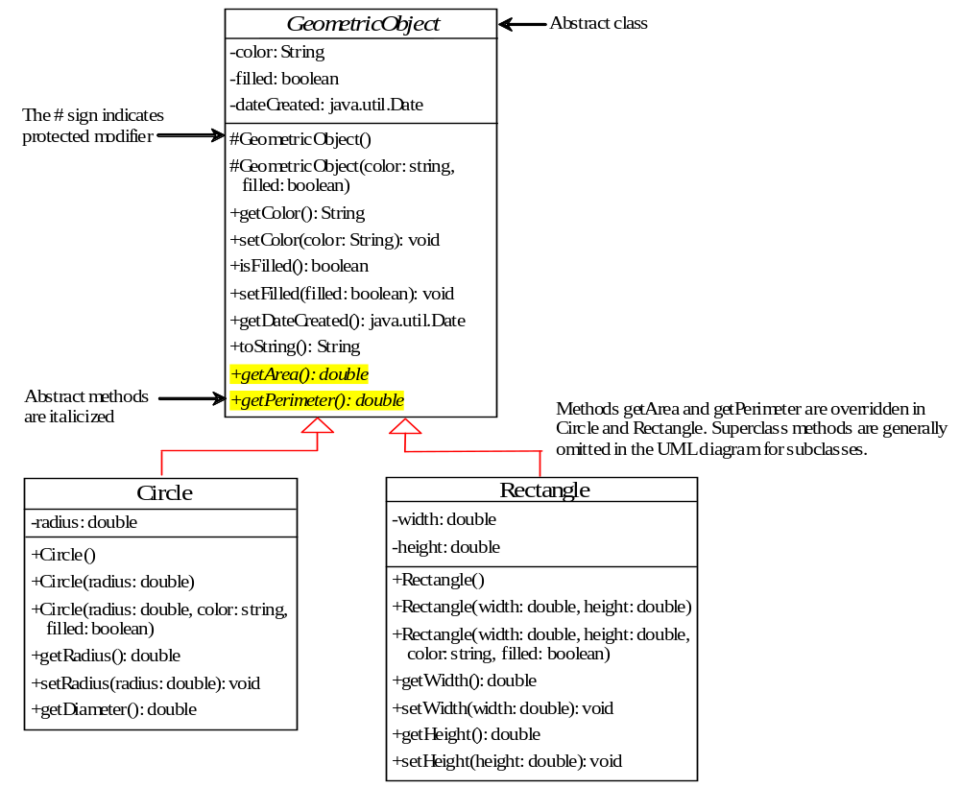
Abstract Classes and Abstract Methods
GeometricObject
Circle
Rectangle
TestGometricObject
Run

Slide 6
abstract method in abstract class
An abstract method cannot be contained in a nonabstract class. If a subclass of an abstract superclass does not implement all the abstract methods, the subclass must be defined abstract. In other words, in a nonabstract subclass extended from an abstract class, all the abstract methods must be implemented, even if they are not used in the subclass.

Slide 7
object cannot be created from abstract class
An abstract class cannot be instantiated using the new operator, but you can still define its constructors, which are invoked in the constructors of its subclasses. For instance, the constructors of GeometricObject are invoked in the Circle class and the Rectangle class.

Slide 8
abstract class without abstract method
A class that contains abstract methods must be abstract. However, it is possible to define an abstract class that contains no abstract methods. In this case, you cannot create instances of the class using the new operator. This class is used as a base class for defining a new subclass.

Slide 9
superclass of abstract class may be concrete
A subclass can be abstract even if its superclass is concrete. For example, the Object class is concrete, but its subclasses, such as GeometricObject, may be abstract.

Slide 10
concrete method overridden to be abstract
A subclass can override a method from its superclass to define it abstract. This is rare, but useful when the implementation of the method in the superclass becomes invalid in the subclass. In this case, the subclass must be defined abstract.

Slide 11
abstract class as type
You cannot create an instance from an abstract class using the new operator, but an abstract class can be used as a data type. Therefore, the following statement, which creates an array whose elements are of GeometricObject type, is correct.
GeometricObject[] geo = new GeometricObject[10];

Slide 12
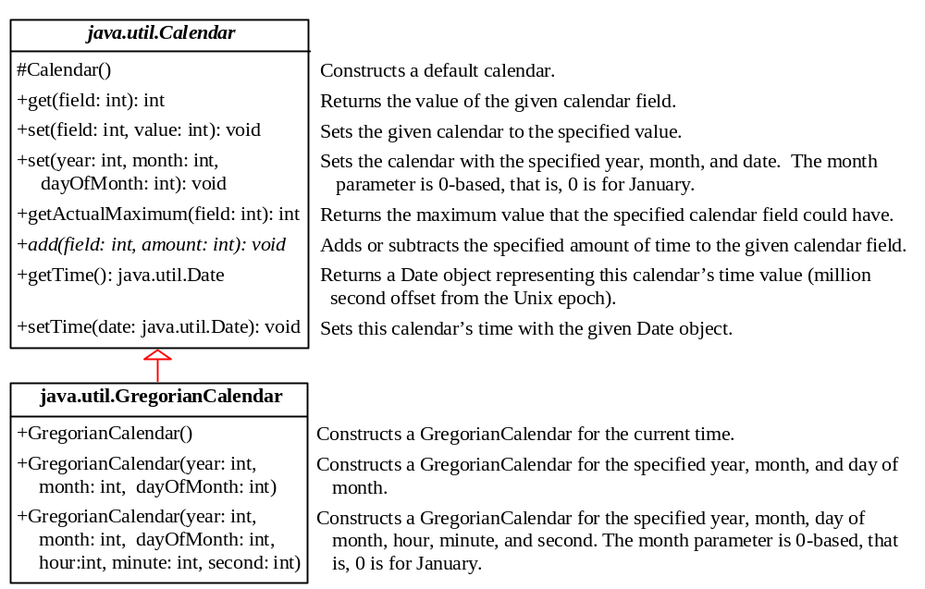
The Abstract Calendar Class and Its GregorianCalendar subclass

Slide 13
The Abstract Calendar Class and Its GregorianCalendar subclass
An instance of java.util.Date represents a specific instant in time with millisecond precision. java.util.Calendar is an abstract base class for extracting detailed information such as year, month, date, hour, minute and second from a Date object. Subclasses of Calendar can implement specific calendar systems such as Gregorian calendar, Lunar Calendar and Jewish calendar. Currently, java.util.GregorianCalendar for the Gregorian calendar is supported in the Java API.

Slide 14
The GregorianCalendar Class
You can use new GregorianCalendar() to construct a default GregorianCalendar with the current time and use new GregorianCalendar(year, month, date) to construct a GregorianCalendar with the specified year, month, and date. The month parameter is 0-based, i.e., 0 is for January.

Slide 15
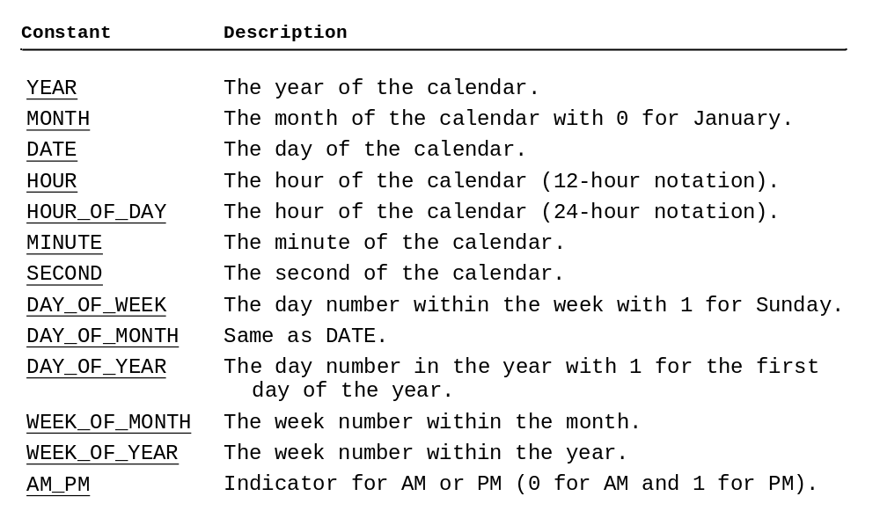
The get Method in Calendar Class
The get(int field) method defined in the Calendar class is useful to extract the date and time information from a Calendar object. The fields are defined as constants, as shown in the following.

Slide 16
Getting Date/Time Information from Calendar
TestCalendar
Run

Slide 17
Interfaces
What is an interface?
Why is an interface useful?
How do you define an interface?
How do you use an interface?

Slide 18
What is an interface?
Why is an interface useful?
An interface is a classlike construct that contains only constants and abstract methods. In many ways, an interface is similar to an abstract class, but the intent of an interface is to specify behavior for objects. For example, you can specify that the objects are comparable, edible, cloneable using appropriate interfaces.

Slide 19
Define an Interface
To distinguish an interface from a class, Java uses the following syntax to define an interface:
public interface InterfaceName {
constant declarations;
method signatures;
}
Example:
public interface Edible {
/** Describe how to eat */
public abstract String howToEat();
}

Slide 20
Interface is a Special Class
An interface is treated like a special class in Java. Each interface is compiled into a separate bytecode file, just like a regular class. Like an abstract class, you cannot create an instance from an interface using the new operator, but in most cases you can use an interface more or less the same way you use an abstract class. For example, you can use an interface as a data type for a variable, as the result of casting, and so on.

Slide 21
Example
You can now use the Edible interface to specify whether an object is edible. This is accomplished by letting the class for the object implement this interface using the implements keyword. For example, the classes Chicken and Fruit implement the Edible interface (See TestEdible).
Run
Edible
TestEdible

Slide 22
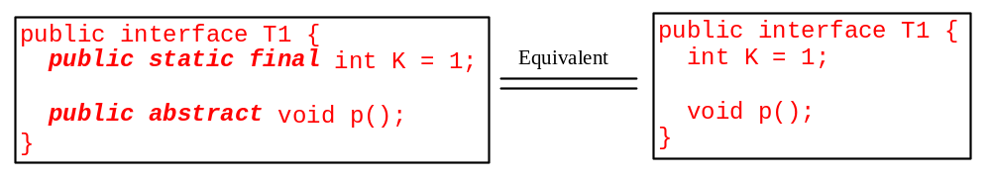
Omitting Modifiers in Interfaces
  All data fields are public final static and all methods are public abstract in an interface. For this reason, these modifiers can be omitted, as shown below:
  A constant defined in an interface can be accessed using syntax InterfaceName.CONSTANT_NAME (e.g., T1.K).

Slide 23
Example: The Comparable Interface
// This interface is defined in
// java.lang package
package java.lang;
public interface Comparable {
public int compareTo(Object o);
}

Slide 24
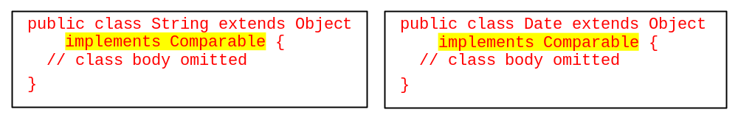
String and Date Classes
Many classes (e.g., String and Date) in the Java library implement Comparable to define a natural order for the objects. If you examine the source code of these classes, you will see the keyword implements used in the classes, as shown below:
new String() instanceof String
new String() instanceof Comparable
new java.util.Date() instanceof java.util.Date
new java.util.Date() instanceof Comparable

Slide 25
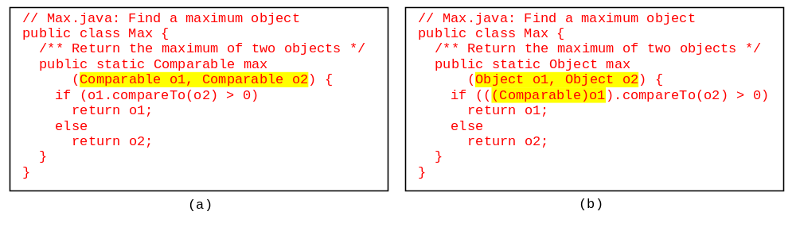
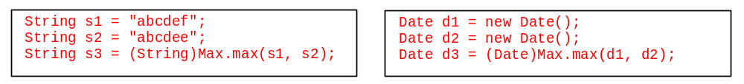
Generic max Method
The return value from the max method is of the Comparable type. So, you need to cast it to String or Date explicitly.

Slide 26
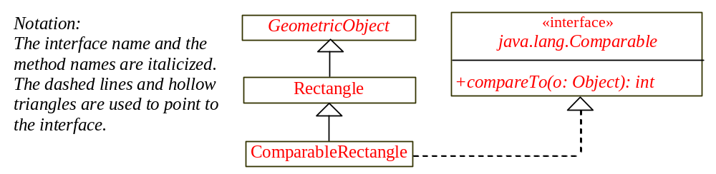
Defining Classes to Implement Comparable
ComparableRectangle
You cannot use the max method to find the larger of two instances of Rectangle, because Rectangle does not implement Comparable. However, you can define a new rectangle class that implements Comparable. The instances of this new class are comparable. Let this new class be named ComparableRectangle.
  ComparableRectangle rectangle1 = new ComparableRectangle(4, 5);
  ComparableRectangle rectangle2 = new ComparableRectangle(3, 6);
  System.out.println(Max.max(rectangle1, rectangle2));

Slide 27
The ActionListener Interfaces
HandleEvent
Run

Slide 28
Handling GUI Events
Source object (e.g., button)
Listener object contains a method for processing the event.

Slide 29
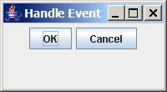
Trace Execution
animation
public class HandleEvent extends JFrame {
public HandleEvent() {
…
OKListenerClass listener1 = new OKListenerClass();
jbtOK.addActionListener(listener1);
…
}
public static void main(String[] args) {
…
}
}
class OKListenerClass implements ActionListener {
public void actionPerformed(ActionEvent e) {
System.out.println("OK button clicked");
}
}
1. Start from the main method to create a window and display it

Slide 30
Trace Execution
animation
public class HandleEvent extends JFrame {
public HandleEvent() {
…
OKListenerClass listener1 = new OKListenerClass();
jbtOK.addActionListener(listener1);
…
}
public static void main(String[] args) {
…
}
}
class OKListenerClass implements ActionListener {
public void actionPerformed(ActionEvent e) {
System.out.println("OK button clicked");
}
}
2. Click OK

Slide 31
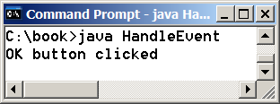
Trace Execution
animation
public class HandleEvent extends JFrame {
public HandleEvent() {
…
OKListenerClass listener1 = new OKListenerClass();
jbtOK.addActionListener(listener1);
…
}
public static void main(String[] args) {
…
}
}
class OKListenerClass implements ActionListener {
public void actionPerformed(ActionEvent e) {
System.out.println("OK button clicked");
}
}
3. Click OK. The JVM invokes the listener’s actionPerformed method

Slide 32
The Cloneable Interfaces
  Marker Interface: An empty interface.
  A marker interface does not contain constants or methods. It is used to denote that a class possesses certain desirable properties. A class that implements the Cloneable interface is marked cloneable, and its objects can be cloned using the clone() method defined in the Object class.
  package java.lang;
  public interface Cloneable {
  }

Slide 33
Examples
Many classes (e.g., Date and Calendar) in the Java library implement Cloneable. Thus, the instances of these classes can be cloned. For example, the following code
  Calendar calendar = new GregorianCalendar(2003, 2, 1);
  Calendar calendarCopy = (Calendar)calendar.clone();
  System.out.println("calendar == calendarCopy is " +
  (calendar == calendarCopy));
  System.out.println("calendar.equals(calendarCopy) is " +
  calendar.equals(calendarCopy));
displays
  calendar == calendarCopy is false
  calendar.equals(calendarCopy) is true

Slide 34
Implementing Cloneable Interface
To define a custom class that implements the Cloneable interface, the class must override the clone() method in the Object class. The following code defines a class named House that implements Cloneable and Comparable.
House

Slide 35
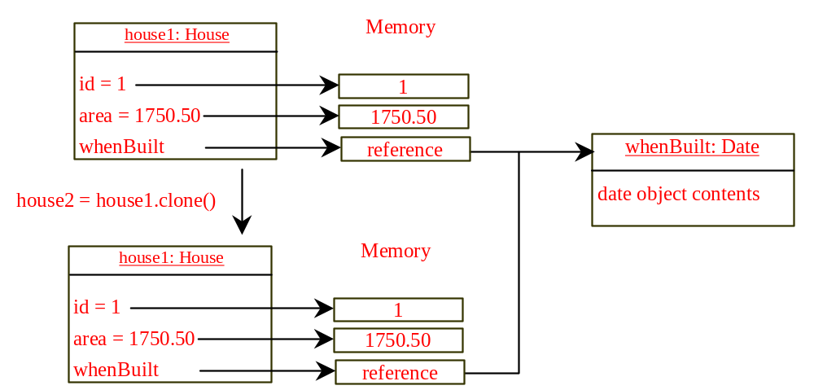
Shallow vs. Deep Copy
House house1 = new House(1, 1750.50);
House house2 = (House)house1.clone();

Slide 36
Interfaces vs. Abstract Classes
  In an interface, the data must be constants; an abstract class can have all types of data.
  Each method in an interface has only a signature without implementation; an abstract class can have concrete methods.
 | Variables | Constructors | Methods
Abstract class | No restrictions | Constructors are invoked by subclasses through constructor chaining. An abstract class cannot be instantiated using the new operator. | No restrictions.
Interface | All variables must be public static final | No constructors. An interface cannot be instantiated using the new operator. | All methods must be public abstract instance methods

Slide 37
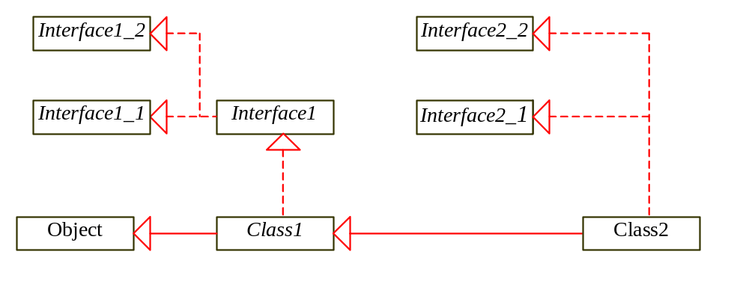
Interfaces vs. Abstract Classes, cont.
  All classes share a single root, the Object class, but there is no single root for interfaces. Like a class, an interface also defines a type. A variable of an interface type can reference any instance of the class that implements the interface. If a class extends an interface, this interface plays the same role as a superclass. You can use an interface as a data type and cast a variable of an interface type to its subclass, and vice versa.
  Suppose that c is an instance of Class2. c is also an instance of Object, Class1, Interface1, Interface1_1, Interface1_2, Interface2_1, and Interface2_2.

Slide 38
Caution: conflict interfaces
  In rare occasions, a class may implement two interfaces with conflict information (e.g., two same constants with different values or two methods with same signature but different return type). This type of errors will be detected by the compiler.

Slide 39
Whether to use an interface or a class?
  Abstract classes and interfaces can both be used to model common features. How do you decide whether to use an interface or a class? In general, a strong is-a relationship that clearly describes a parent-child relationship should be modeled using classes. For example, a staff member is a person. So their relationship should be modeled using class inheritance. A weak is-a relationship, also known as an is-kind-of relationship, indicates that an object possesses a certain property. A weak is-a relationship can be modeled using interfaces. For example, all strings are comparable, so the String class implements the Comparable interface. You can also use interfaces to circumvent single inheritance restriction if multiple inheritance is desired. In the case of multiple inheritance, you have to design one as a superclass, and others as interface. See Chapter 10, “Object-Oriented Modeling,” for more discussions.

Slide 40
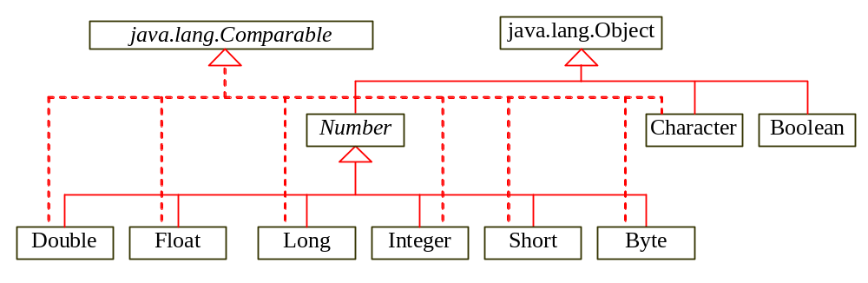
Wrapper Classes
Boolean
Character
Short
Byte
Integer
Long
Float
Double
NOTE: (1) The wrapper classes do not have no-arg constructors. (2) The instances of all wrapper classes are immutable, i.e., their internal values cannot be changed once the objects are created.

Slide 41
The toString, equals, and hashCode Methods
Each wrapper class overrides the toString, equals, and hashCode methods defined in the Object class. Since all the numeric wrapper classes and the Character class implement the Comparable interface, the compareTo method is implemented in these classes.

Slide 42
The Number Class
Each numeric wrapper class extends the abstract Number class, which contains the methods doubleValue, floatValue, intValue, longValue, shortValue, and byteValue. These methods “convert” objects into primitive type values. The methods doubleValue, floatValue, intValue, longValue are abstract. The methods byteValue and shortValue are not abstract, which simply return (byte)intValue() and (short)intValue(), respectively.

Slide 43
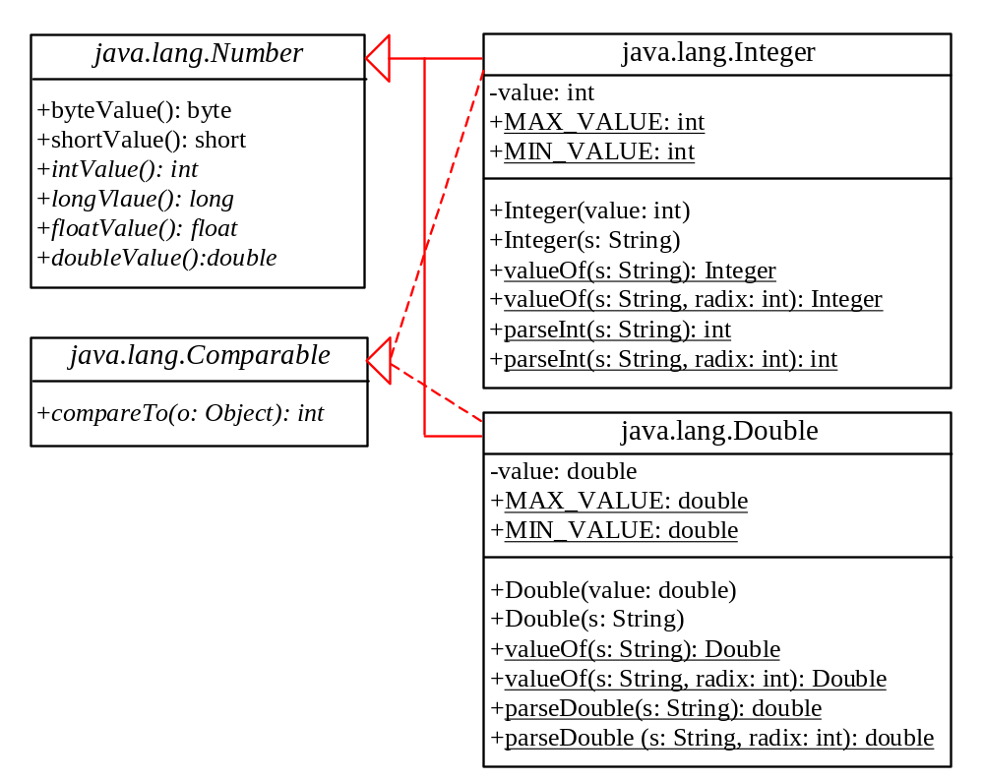
The Integer and Double Classes

Slide 44
The Integer Class and the Double Class
Constructors
Class Constants MAX_VALUE, MIN_VALUE
Conversion Methods

Slide 45
Numeric Wrapper Class Constructors
You can construct a wrapper object either from a primitive data type value or from a string representing the numeric value. The constructors for Integer and Double are:
  public Integer(int value)
  public Integer(String s)
  public Double(double value)
  public Double(String s)

Slide 46
Numeric Wrapper Class Constants
Each numerical wrapper class has the constants MAX_VALUE and MIN_VALUE. MAX_VALUE represents the maximum value of the corresponding primitive data type. For Byte, Short, Integer, and Long, MIN_VALUE represents the minimum byte, short, int, and long values. For Float and Double, MIN_VALUE represents the minimum positive float and double values. The following statements display the maximum integer (2,147,483,647), the minimum positive float (1.4E-45), and the maximum double floating-point number (1.79769313486231570e+308d).

Slide 47
Conversion Methods
Each numeric wrapper class implements the abstract methods doubleValue, floatValue, intValue, longValue, and shortValue, which are defined in the Number class. These methods “convert” objects into primitive type values.

Slide 48
The Static valueOf Methods
The numeric wrapper classes have a useful class method, valueOf(String s). This method creates a new object initialized to the value represented by the specified string. For example:
  Double doubleObject = Double.valueOf("12.4");
  Integer integerObject = Integer.valueOf("12");

Slide 49
The Methods for Parsing Strings into Numbers
You have used the parseInt method in the Integer class to parse a numeric string into an int value and the parseDouble method in the Double class to parse a numeric string into a double value. Each numeric wrapper class has two overloaded parsing methods to parse a numeric string into an appropriate numeric value.

Slide 50
Sorting an Array of Objects
Objective: The example presents a generic method for sorting an array of objects. The objects are instances of the Comparable interface and they are compared using the compareTo method.
GenericSort
Run

Slide 51
TIP
Java provides a static sort method for sorting an array of Object in the java.util.Arrays class. So you can use the following code to sort arrays in this example:
  java.util.Arrays.sort(intArray);
  java.util.Arrays.sort(doubleArray);
  java.util.Arrays.sort(charArray);
  java.util.Arrays.sort(stringArray);

Slide 52
NOTE
Arrays are objects. An array is an instance of the Object class. Furthermore, if A is a subclass of B, every instance of A[] is an instance of B[]. Therefore, the following statements are all true:
  new int[10] instanceof Object
  new GregorianCalendar[10] instanceof Calendar[];
  new Calendar[10] instanceof Object[]
  new Calendar[10] instanceof Object

Slide 53
CAUTION
Although an int value can be assigned to a double type variable, int[] and double[] are two incompatible types. Therefore, you cannot assign an int[] array to a variable of double[] or Object[] type.

Slide 54
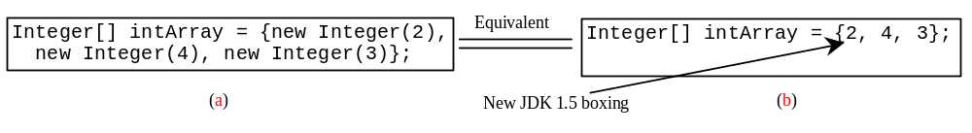
Automatic Conversion Between Primitive Types and Wrapper Class Types
JDK 1.5 allows primitive type and wrapper classes to be converted automatically. For example, the following statement in (a) can be simplified as in (b):
Integer[] intArray = {1, 2, 3};
System.out.println(intArray[0] + intArray[1] + intArray[2]);
Unboxing

Slide 55
BigInteger and BigDecimal
If you need to compute with very large integers or high precision floating-point values, you can use the BigInteger and BigDecimal classes in the java.math package. Both are immutable. Both extend the Number class and implement the Comparable interface.

Slide 56
BigInteger and BigDecimal
BigInteger a = new BigInteger("9223372036854775807");
BigInteger b = new BigInteger("2");
BigInteger c = a.multiply(b); // 9223372036854775807 * 2
System.out.println(c);
LargeFactorial
Run
BigDecimal a = new BigDecimal(1.0);
BigDecimal b = new BigDecimal(3);
BigDecimal c = a.divide(b, 20, BigDecimal.ROUND_UP);
System.out.println(c);

Slide 57
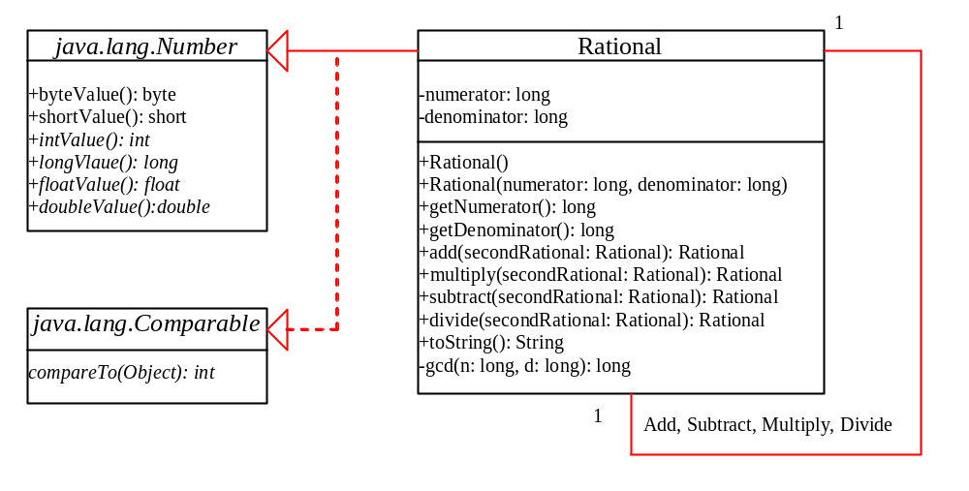
The Rational Class
Rational
TestRationalClass
Run

